Slide 1


Web technologies
Accessing MySQL from Nodejs
Reg no:
211FA04572
211FA04606
211FA04615
211FA04617

Slide 2

What is Node.js?
Node.js is an open source server environment which allows us to run JavaScript on the server.
It's primarily used as a back-end server environment, but it can also be used for front-end web development.

Slide 3

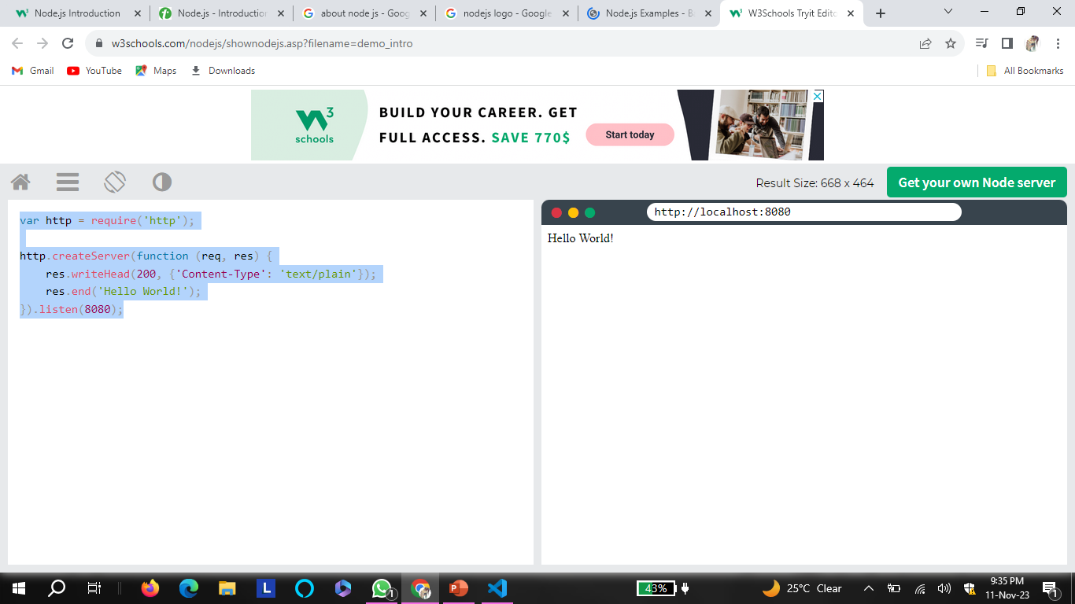
Basic Node.js Script:
var http = require('http');
http.createServer(function (req, res) {
res.writeHead(200, {'Content-Type': 'text/plain'});
res.end('Hello World!');
}).listen(8080);

Slide 4
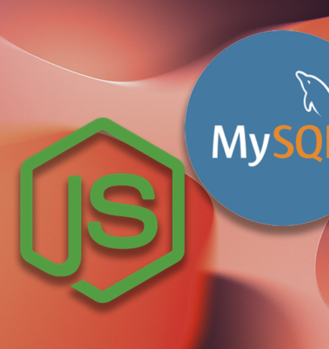
Accessing MYSQL from Node.js
To access a MySQL database with Node.js, you need a MySQL driver. This tutorial will use the "mysql" module, downloaded from NPM.
Node.js can use this module to manipulate the MySQL database:
var mysql = require('mysql');

Slide 5
Accessing mysql from Node.js
To create a Nodejs app for MySQL, first create a folder and use npm init to develop the package.json file, then install node.js for the MySQL package.
npm install mysql
In this step, you need to create the connect.js script within the node-mysql folder to store the code that links to the MySQL Database Server.
CREATE DATABASE todoapp;
Once you’ve created the database, you can go about connecting it from the Nodejs application.

Slide 6
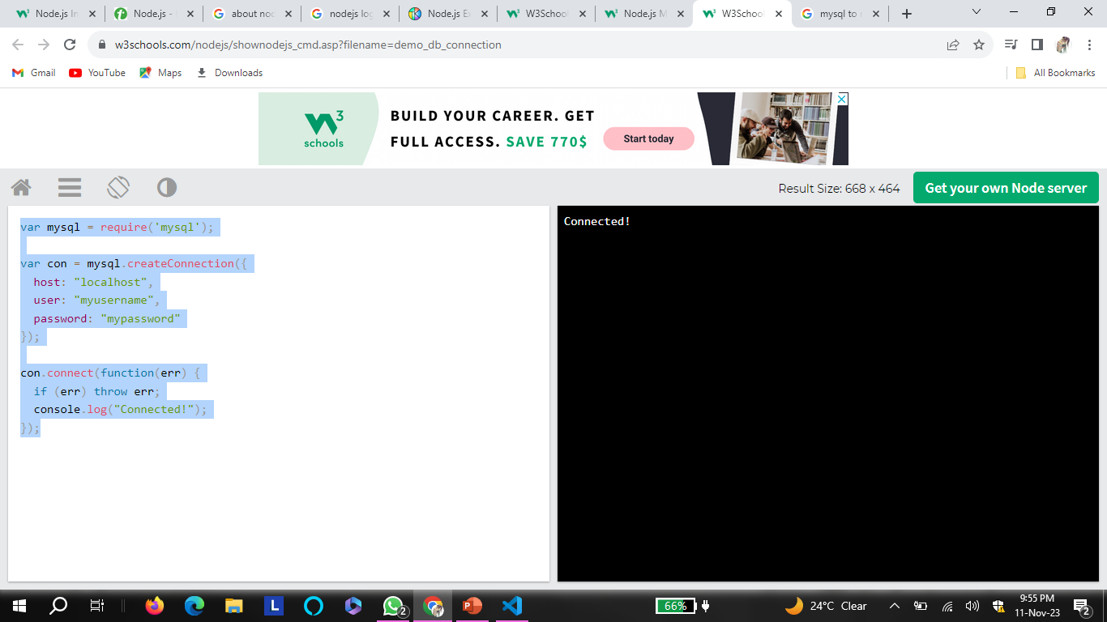
Connection:
var mysql = require('mysql');
var con = mysql.createConnection({
host: "localhost",
user: "myusername",
password: "mypassword"
});
con.connect(function(err) {
if (err) throw err;
console.log("Connected!");
});

Slide 7
Query a Database
Use SQL statements to read from (or write to) a MySQL database. This is also called "to query" the database.
con.connect(function(err) {
if (err) throw err;
console.log("Connected!");
con.query(sql, function (err, result) {
if (err) throw err;
console.log("Result: " + result);
});
});

Slide 8
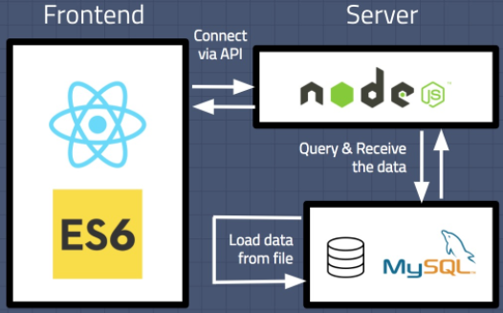

Slide 9
Conclusion
Accessing MySQL from Node.js requires understanding and implementing asynchronous operations, connection pooling, error handling, security measures, middleware integration, ORM libraries, testing, and scalability considerations to build robust and performant applications.

Slide 10


